Slide 1
ELECTRICAL SCIENCE-1 (15B11EC111) UNIT-1 Lecture-2

Slide 2
Topics to be Discussed
Circuit
Circuit elements-R, L and C
Charge
Current
Voltage
Numericals
References

Slide 3
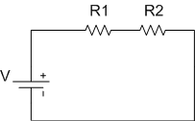
Circuit [1]
An electrical circuit is a closed path consisting of active and passive elements all interconnected and the current flow is confined to the closed path.
An active element is one which supplies energy to the circuit whereas passive element is one which receives energy and then this energy is converted into heat (resistor) or stores it in an electric (capacitor) or magnetic field (inductor).

Slide 4

Circuit elements [2,3]
There are passive and active circuit elements. Here, we will review passive circuit elements.
Resistance
The opposition offered by a substance to the flow of electric current is called its resistance.
The practical unit of resistance is ohm and is represented by the symbol Ω.
The reciprocal of resistance of a conductor is called its conductance (G).

Slide 5
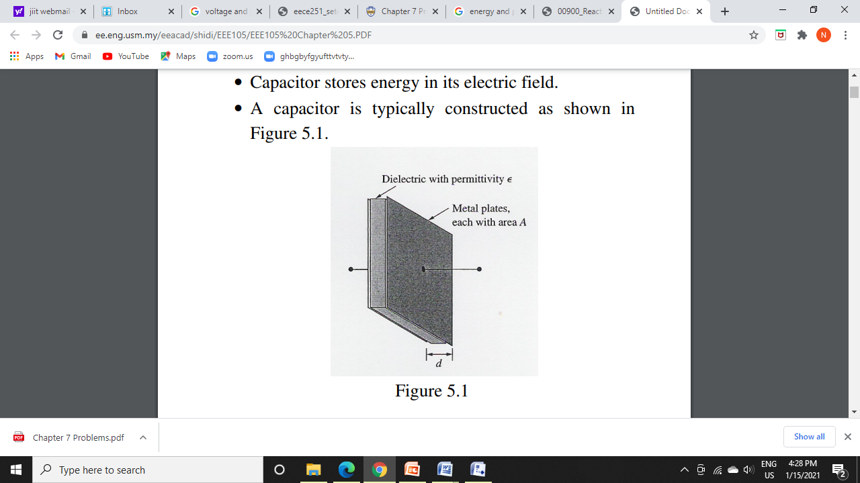


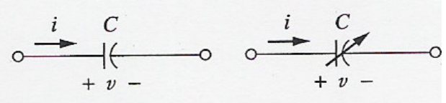

Capacitor-
Capacitor stores energy in its electric field.
A capacitor consists of two conducting plates separated by an insulator or dielectric.
Capacitance is the ratio of charge
on one plate to the voltage
difference between the two plates.
Capacitance depends on the
physical dimensions of the
capacitor.
For parallel plate capacitor,

Slide 6
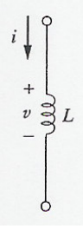
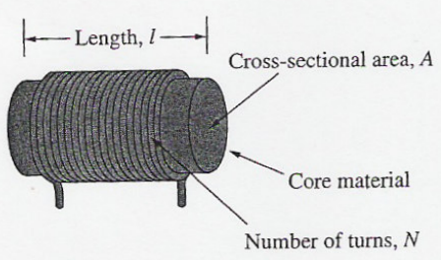


Inductor
Inductor is a passive element designed to store energy in its magnetic field.
An inductor consists of a coil of conducting wire.
The unit of inductance is Henry.
For inductor,
Under dc conditions, inductor behaves as short circuit and capacitor as open circuit.

Slide 7
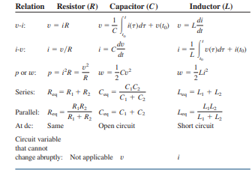
Important characteristics of circuit elements [3]

Slide 8
Charge [1]
Under normal conditions, atom is considered to be electrically neutral. It means the total positive charge on protons is equal to the total negative charge on electrons.
If an atom loses electrons, it becomes positively charged. On the other hand, if an atom acquires excess electrons, it becomes negatively charged.
The charge can be considered as the quantity of electricity.
The unit of charge is coulomb (C).
Charge may flow in an electrical circuit, which is basically interconnection of electrical elements linked together in a closed path so that an electric current may flow continuously.
Charge is the quantity of electricity responsible for electric phenomena.

Slide 9

Current [1]
Current is the time rate of change of charge past a given point, where charge is the intrinsic property of matter responsible for electric phenomena.
The quantity of charge can be expressed in terms of the charge on an electron i.e. 1.602 x 10⁻¹⁹ coulombs (C). Thus, -1 C is the charge on 6.24 x 10¹⁸ electrons.
The current through a specified area is defined by the electric charge passing through the area per unit of time. Thus q is defined as the charge expressed in coulombs.
The unit of current is ampere (A). An ampere is 1 coulomb per second.

Slide 10
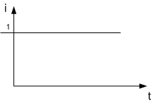
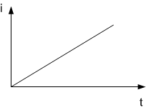
A direct current is a current of constant magnitude.
A time-varying current i(t) can take many forms such as ramp, sinusoid, or an exponential. The sinusoidal current is called an alternating current (ac).

Slide 11

If current, i is given, charge q can be readily calculated.
Where q(0) is the charge at t=0.
Q. Find the current in an element when the charge entering the element is q = 12t C, where time, t is in seconds.
Ans. I = 12 A
Q. Find the charge that has entered an element by time, t when I = 8t²-4t A, t>0 A. Assume q(t)=0 for t<0.
Ans. (8/3)t³-2t² C

Slide 12

Voltage or potential [1]
The absolute potential of a point is defined as the amount of work done to bring a unit positive charge from infinity to that point.
The basic variables in an electric circuit are current and voltage.
When considering v_{ba}, the terminal b is called + terminal and terminal a is called the – terminal.
On the other hand, for v_{ab}, the terminal a is called + terminal and terminal b is called – terminal.

Slide 13

Numericals
Q1. The current i(t) in a 100 mH inductor connected in a telephone circuit changes according to:
Where the units of time are seconds and the units of current are amperes. Determine the voltage in the inductor.

Slide 14

Ans.
Therefore,

Slide 15

Q2. The voltage v(t) across a 25 mH inductor used in a fusion power experiment is:
Where the units of time are s and the units of voltage are V. The current in this inductor is zero before the voltage changes at t=0. Determine the current in the inductor.

Slide 16

Ans.
Therefore,

Slide 17


Q3. Consider an inductor of 2.5 H. The current and voltage are given by
And
Where a, b, and c are real constants. Determine the values of a, b and c.

Slide 18
Ans.
a=10 A/s, b=-5.6 A and c=-0.6 A

Slide 19


Q4. Consider a capacitor of 0.25 F. The current and voltage are given by
And

Slide 20
Ans.
a=8 V/s, b=5.6 V and c=17.6 V

Slide 21
References
R.C. Dorf and James A. Svoboda, “Introduction to Electric Circuits”, 9th ed, John Wiley & Sons, 2013.
D.C. Kulshreshtha, Basic Electrical Engineering, Revised 1st ed, Tata Mc Graw Hill, 2017.
V. K.Mehta, Rohit Mehta, Basic Electrical Engineering, 6th ed, S. Chand Publishing, 2012.

